Slide 1

BeAware: Suspicious Activity Reporting and Alerting Application
Akshay Ghorpade
AMSE, California State University, Fullerton

Slide 2
Agenda
Introduction
Approach
Demo
Desired outcomes
Conclusion

Slide 3
Introduction

Slide 4
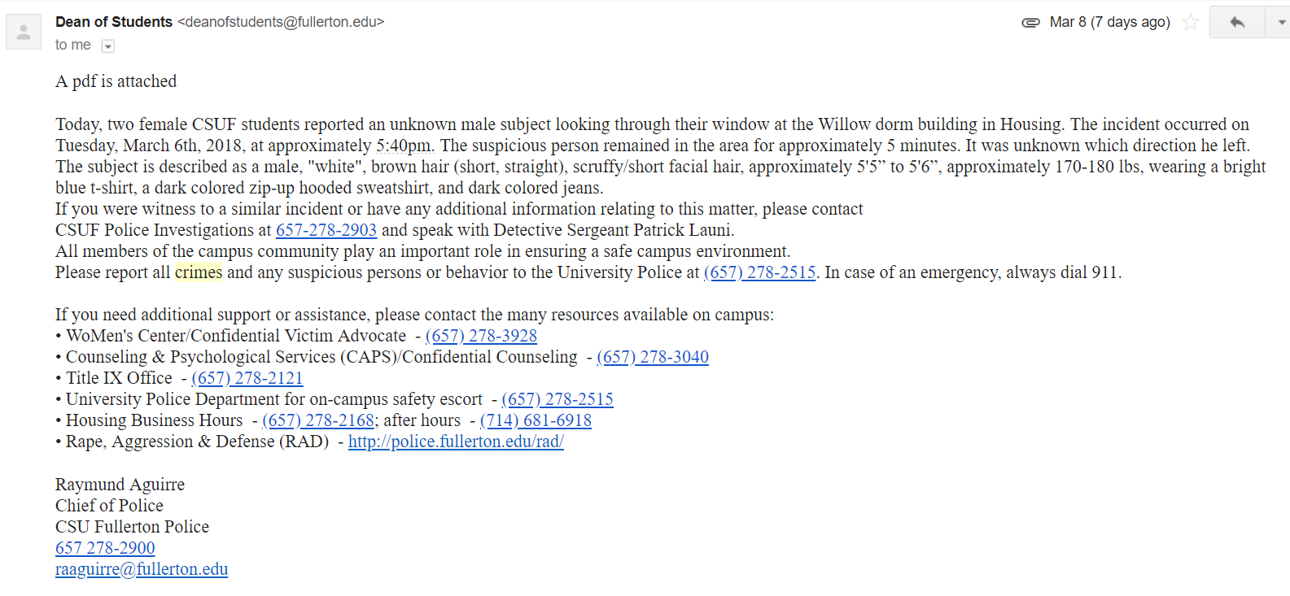
Introduction
What is Suspicious Reporting Application?
Why it is needed?

Slide 5
Introduction
How Suspicious Activity Reporting and Alerting is better approach?
Easy and dynamic way to report or alert Suspicious Activity.
Push Notification and email alert regarding the Suspicious Activity.
Report and Analysis of the reported activities for Campus Police Department.
Heat map analysis for understanding the high alert areas. To be implemented
Application provides 99.999% system availability.

Slide 6
Modules

Slide 7
Modules
Suspicious Activity Report
Suspicious Activity Map
Self Registration Page
Single Page Application
Report and Dashboard Analysis
Heat Map – To be implemented

Slide 8
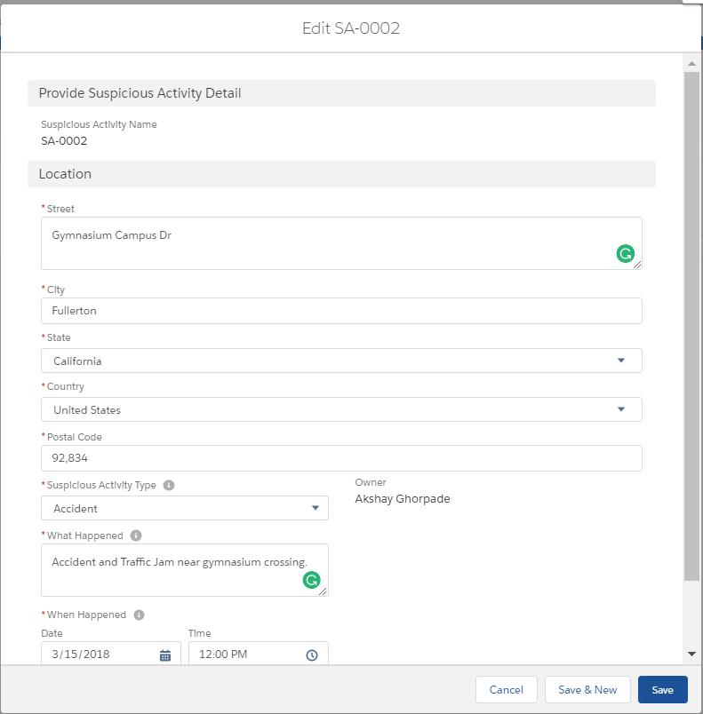
Suspicious Activity Report

Slide 9

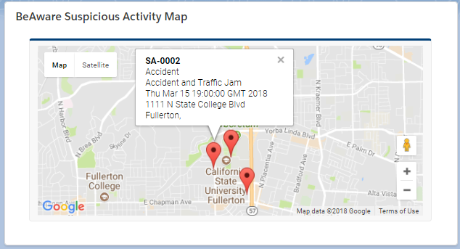
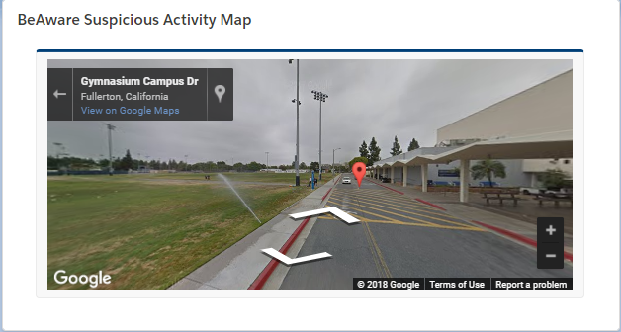
Suspicious Activity Map

Slide 10
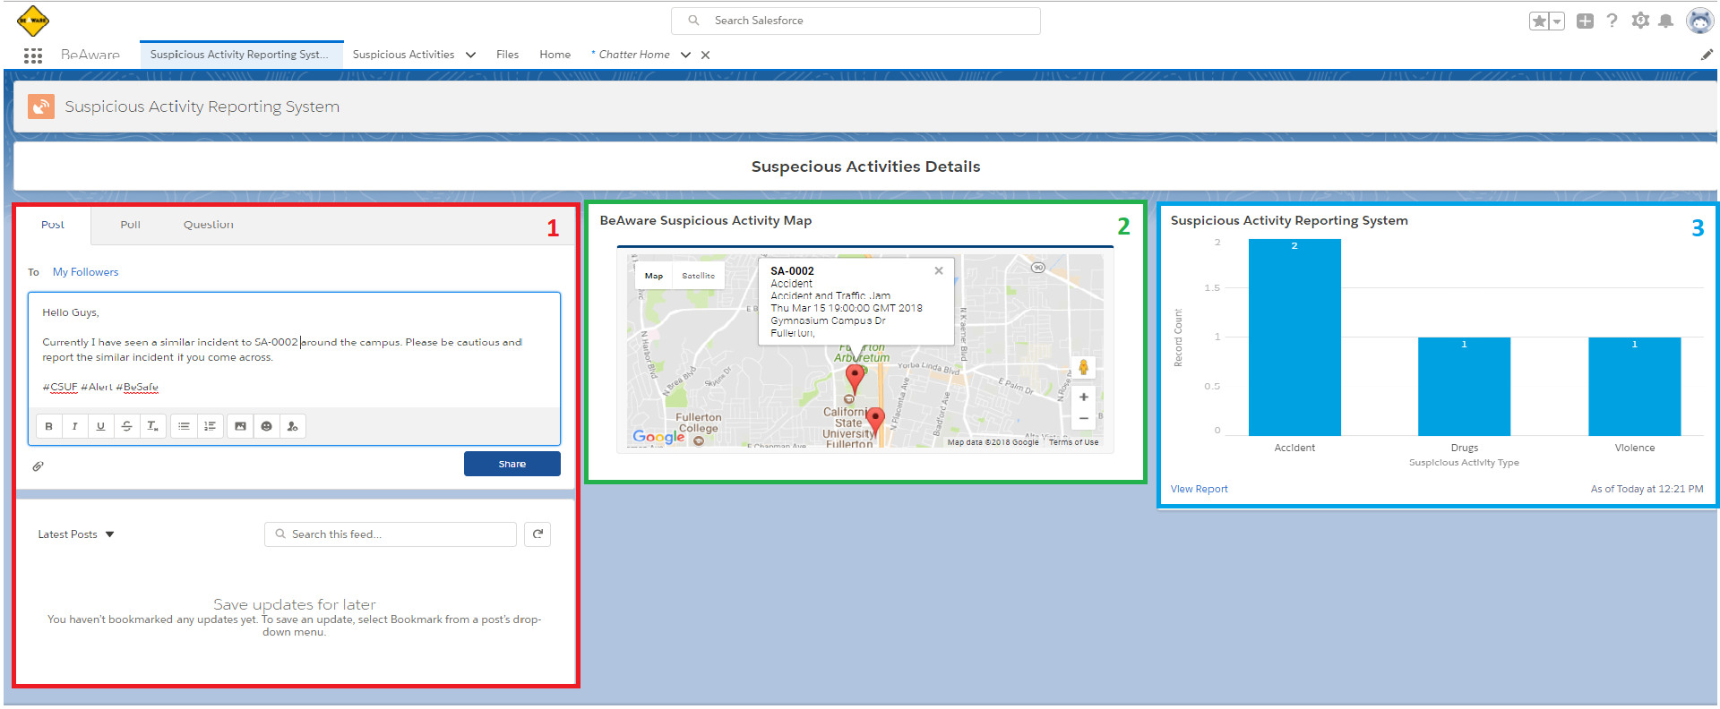
Single Page Application

Slide 11
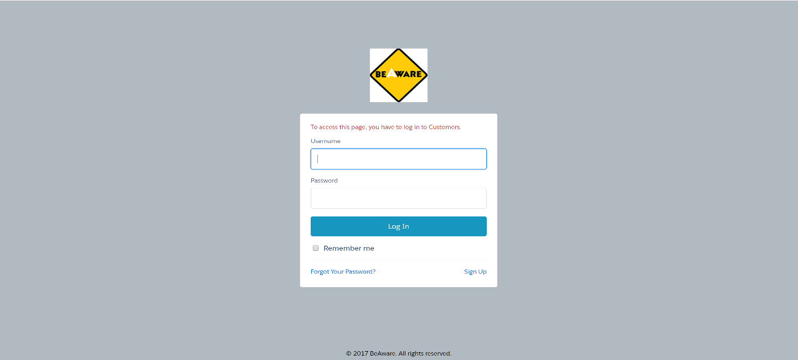
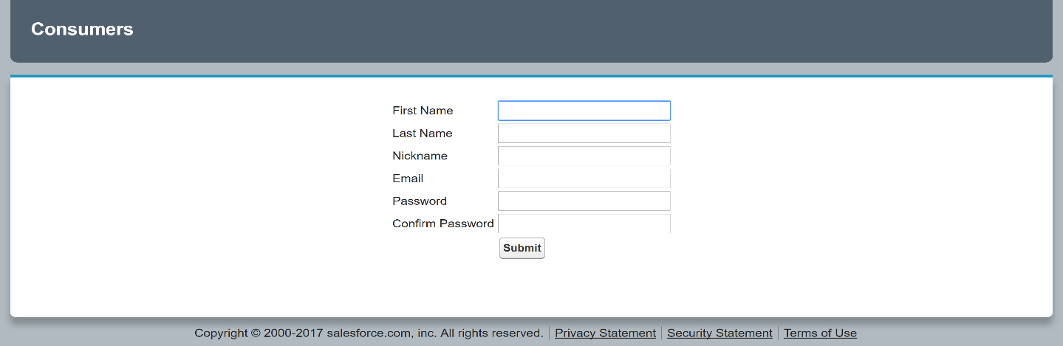
Self Registration Page

Slide 12
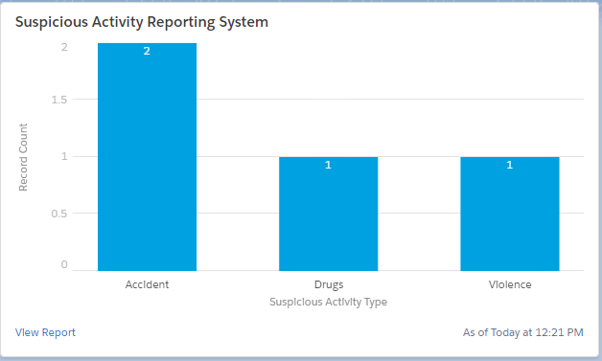
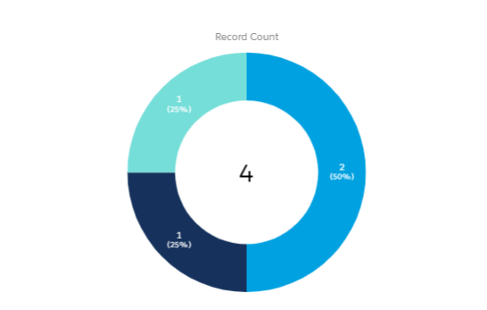
Report and Dashboard Analysis

Slide 13
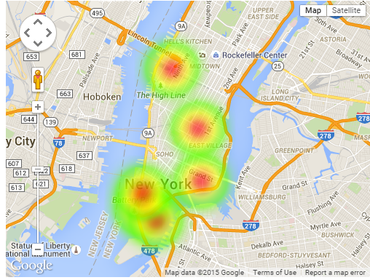
Heat Map

Slide 14
Desired Outcomes
Increased Report Accuracy and Duration by 60%.
The application support multi-platform i.e. it should run on Android and IOS devices.
Smooth rendering of the application and map with a precise accuracy of 99.999% to locate a suspicious activity on the map.
This application provides 99.999% availability
This application will help students to be aware of the suspicious activities and become cautious to avoid it happening with them.
Reduces the process time by 80% to aware students about the suspicious activities or alert with the precise location on the map.
At the later point as the basic requirement is achieve a module of lost and found feature will be added to the main application along with the object recognition system using AI.

Slide 15
Demo

Slide 16
Conclusion

Slide 17
Thank You

